Slide 1
Using fantasy football stats to predict NFL win percentage
Michael Brown
Zack Soden
DATA 606 - Spring 2022

Slide 2
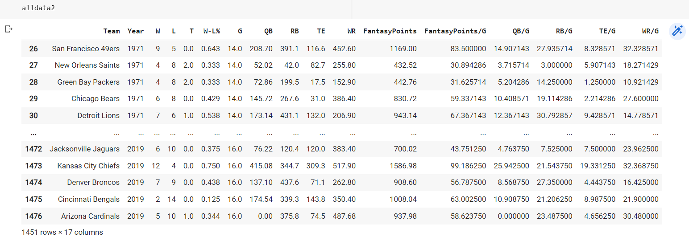
Dataset

Slide 3
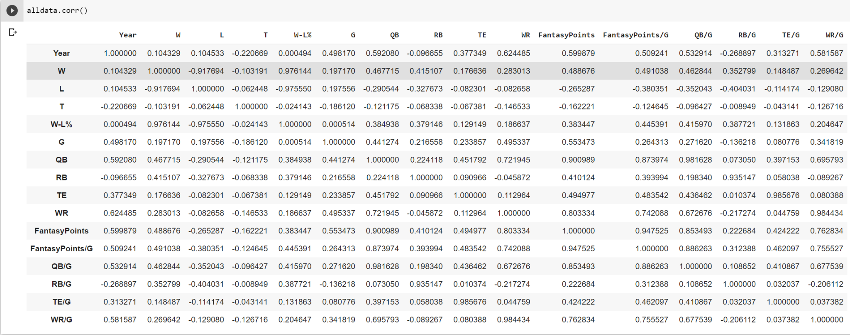
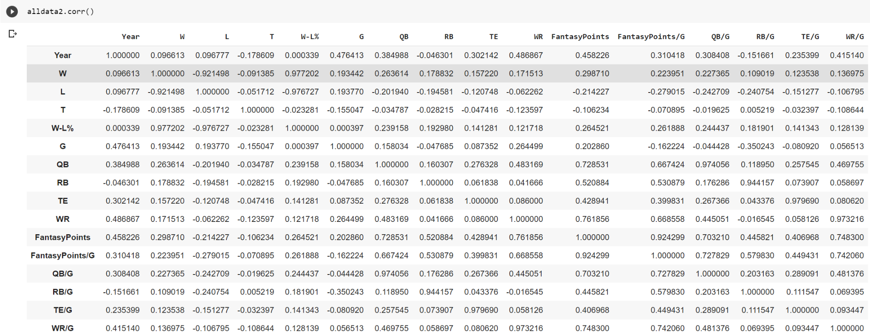
Trends/Correlations
Data is now the stats from the previous year
Correlations have dropped across the board
This makes sense because the stats are further removed from the win percentage

Slide 4
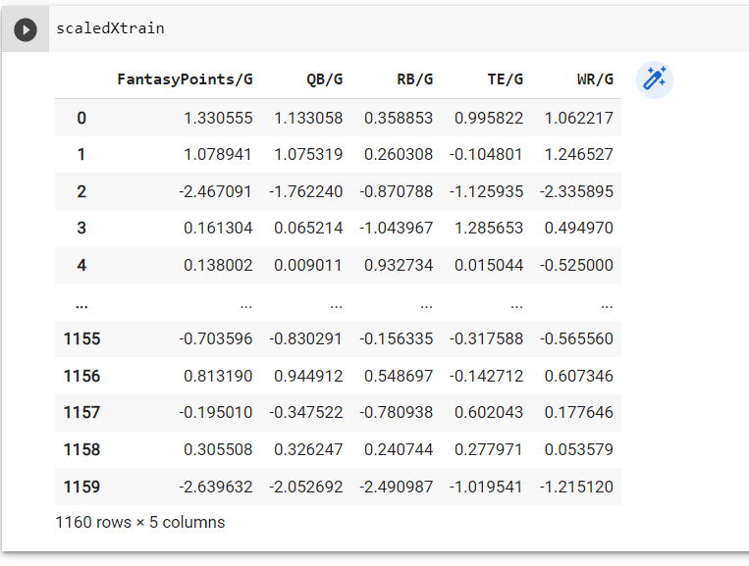
Training the model
Split data into testing and training sets
X -Features include the per game average fantasy points scored from each position
Y - the win/loss percentage we are trying to predict
Scaled training dataset depicted on the right

Slide 5
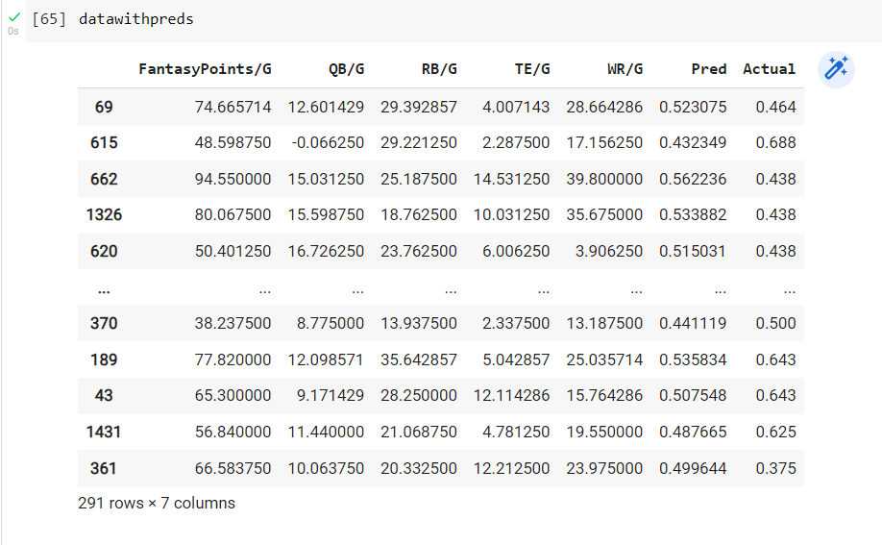
Model evaluation
Score of test sets was .091

Slide 6
Next Steps
Seeing if we can improve our accuracy score by
limiting the number of players (ex. Taking the top scorers by position from each team)
Game by game approach instead of averaging the season totals
Analyze current results to see how win percentage predictions are being made
Begin drafting blog post

